Slide 1

Finding the Boats

Slide 2



The Problem
Oceans are getting busy
Naval shipping
Recreational boating
Underwater Construction
All produce noise
Noise Pollution is not just in the air

Slide 3
Applications
National Defense
Traffic coordination, preventing collisions
Monitoring illegal activities
unregulated fishing
maritime smuggling.
Able to increase ocean policing effectiveness
Environmental Protection
Reducing underwater noise pollution
Optimizing ship design for:
Decreasing drag
Higher top speeds
Quieter operation
Scientific Research:
Marine biology
Migratory patterns
Impact of ship traffic
Improved rescue operations
Quicker identification

Slide 4


Previous Methods
Feature Extraction and Processing
Classification

Slide 5
Previous Works:
Underwater target classification in changing environments using an adaptive feature mapping
By: M.R. Azimi-Sadjadi; D. Yao; A.A. Jamshidi; G.J. Dobeck
Undersea Target Classification Using Canonical Correlation Analysis
By: Ali Pezeshki; Mahmood R. Azimi-Sadjadi; Louis L. Scharf
Preprocessing passive sonar signals for neural classification
By: Filho, W.S., De Seixas, J.M., De Moura, N.N.
Extraction and classification of acoustic scattering from underwater target based on Wigner-Ville distribution
Yushuang Wu a b, Xiukun Li a b, Yang Wang c
Individual Ship Detection Using Underwater Acoustics
Damianos Karakos; Jan Silovsky; Richard Schwartz; William Hartmann; John Makhoul
Acoustic Classification of Surface and Underwater Vessels in the Ocean Using Supervised Machine Learning
Choi, J., Choo, Y., & Lee, K.

Slide 6
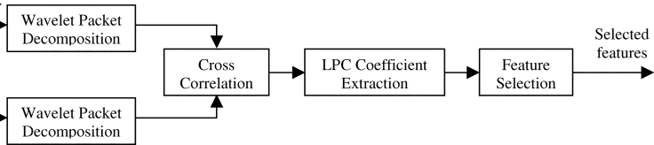
1. Underwater target Processing
Wavelet packet decomposition
Linear Predictive Coding (LPC)
Fisher Criterion for Feature Selection
Notes:
• Wavelet Packet Decomposition:
▪ Splits the signal's frequency spectrum into multiple subbands using a wavelet packet filter bank
▪ Allows capturing fine spectral details and subtle features in the signals
• Linear Predictive Coding (LPC):
▪ Models the signal as an autoregressive process
▪ Computes a set of LPC coefficients that represent the spectral characteristics of each subband signal
▪ The LPC coefficients are then used as feature inputs to the classifier
• Fisher Criterion for Feature Selection:
▪ Evaluates the discriminatory power of each individual feature
▪ Selects the features with higher discriminatory ability, reducing the dimensionality of the feature space
▪ This helps remove noise and irrelevant features, improving classification performance

Slide 7

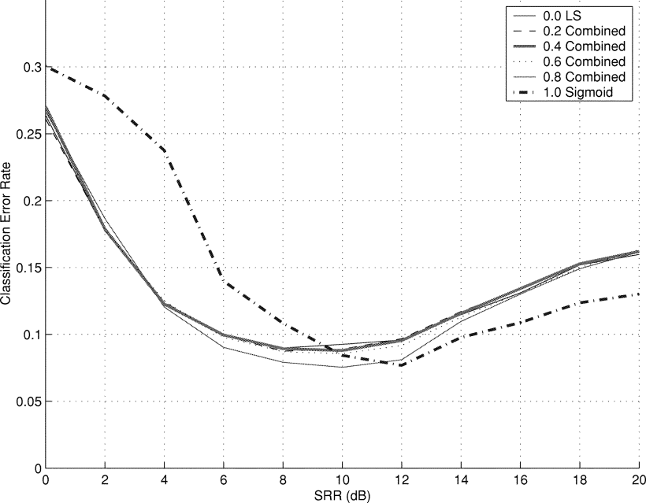
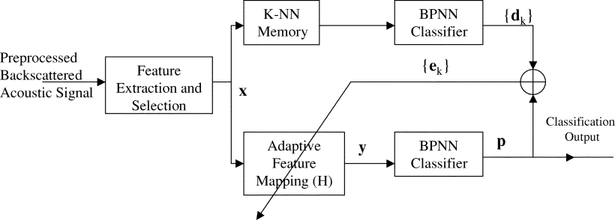
1. Underwater target Classification
Two-layer backpropagation neural network (BPNN)
target vs. non-target discrimination
K-nearest neighbor (K-NN) provide closest matching patterns
Adaptive feature mapping system maps BPNN outputs invariant to environmental changes
Two adaptation mechanisms explored:
Least squares error criterion to move BPNN output to centroid of K-NN evidence
2D sigmoid cost function to maximize gap between BPNN outputs
Combining the two criteria improves overall classification confidence
Notes:
SRR refers to the ratio of the target signal strength to the reverberation signal strength, which was varied from 0 dB to 20 dB in the testing dataset, to simulate different environmental conditions compared to the training data.
"Least Squares" error criterion.
Least squres top
Sigmoid bottom

Slide 8
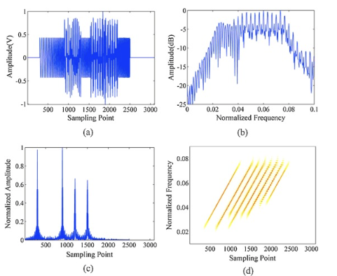
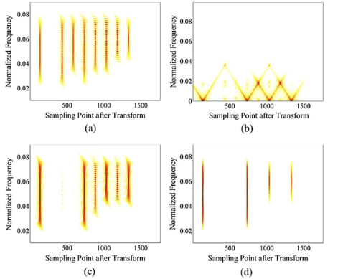
3. Preprocessing passive sonar signals for neural classification
Determine the locations of the highlights
Extract the highlights
SVM then used to classify the different features
Notes:
The energy sum, instantaneous frequency variance, and instantaneous frequency entropy are used to detect the existence and position of the highlights.
The highlights can be regarded as impulse functions, while the background is a random distribution. These three characteristics are effective in detecting even weak highlights by combining them.

Slide 9
5. Individual Ship Detection Processing
Short-time spectral analysis using a 3-second analysis window computed every 1 second.
Disk noise removal to remove artifacts caused by the disk drive while recording data.
A non-linear filterbank where the 3000 spectral values between 0 and 1 kHz are summed into 400 triangular filters.
Temporal averaging where the filter energies computed every 1 second are averaged over an interval of 3 seconds.
Dimensionality reduction using PCA.
Principal Component Analysis (PCA) : transforms the original high-dimensional feature vectors into a lower-dimensional space
Optionally, i-vector computation to reduce the feature vectors into a single vector.

Slide 10
5. Individual Ship Detection Classification
Performance related the EER metric:
The False Alarm (FA) rate and Miss rate are computed for each target ship and different detection thresholds.
The Equal Error Rate (EER) is the point on the Receiver Operating Characteristic (ROC) curve where the False Alarm rate equals the Miss rate.
A lower EER indicates better performance
Neural Network Modeling
Uses a neural network with one hidden layer
Input is a single 400-dimensional feature vector
Output layer has 101 outputs - 100 for the labeled ships and 1 for the "other" category
Trained using backpropagation and cross-entropy loss
Notes:
The ROC (Receiver Operating Characteristic) curve is a graphical plot that illustrates the performance of a binary classification system as its discrimination threshold is varied.
Specifically, for the ship detection task described in the paper:
• The x-axis of the ROC curve represents the False Alarm rate (pFA)
• The y-axis represents the Miss rate (pMiss)
EER: it means the system can achieve a lower False Alarm rate for a given Miss rate, or vice versa.

Slide 11

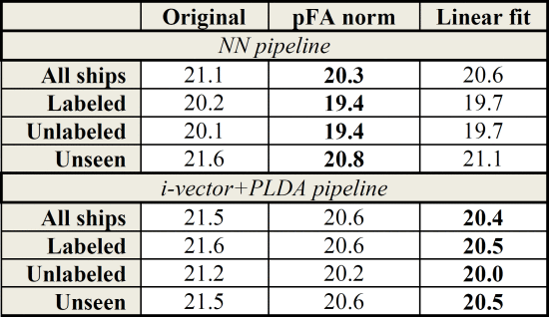
5. Individual Ship Detection Classification Continued
I-vector and PLDA Modeling:
First reduces feature dimensionality from 400 to 60 using PCA
Estimates a universal background Gaussian mixture model (GMM)
Computes per-Gaussian posteriors and adapts the GMM means to get a supervector
Projects the supervector into an i-vector space of 60 dimensions
Uses Probabilistic Linear Discriminant Analysis (PLDA) to model the between-class and within-class variabilities in the i-vectors

Slide 12
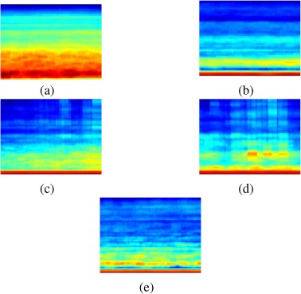
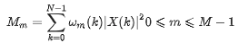
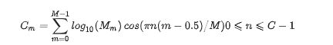
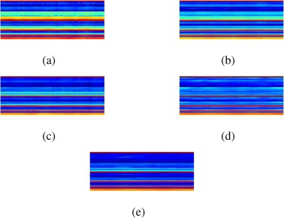
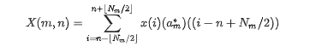
Deep Ship Processing
Cepstrum
Mel spectrogram
MFCC
CQT
GFCC
Wavelet packets
Notes:
1. Cepstrum: Analysis tool for finding pattern rates in spectral components of a signal.
2. Mel Spectrogram: Represents audio frequencies on a Mel scale, which approximates human auditory response.
3. MFCC (Mel-Frequency Cepstral Coefficients): Compact representation of sound, based on a cosine transform of a log power spectrum on a nonlinear Mel frequency scale.
4. CQT (Constant Q Transform): Transform that represents audio on a logarithmic scale, useful for musical data. Means quality
5. GFCC (Gammatone Frequency Cepstral Coefficients): Like MFCC, but with a filter bank more closely resembling the human auditory response.
6. Wavelet Packets: A signal representation using wavelet basis functions, providing a localized frequency analysis.

Slide 13

Structure of DeepShip
Proposed Structure

Slide 14
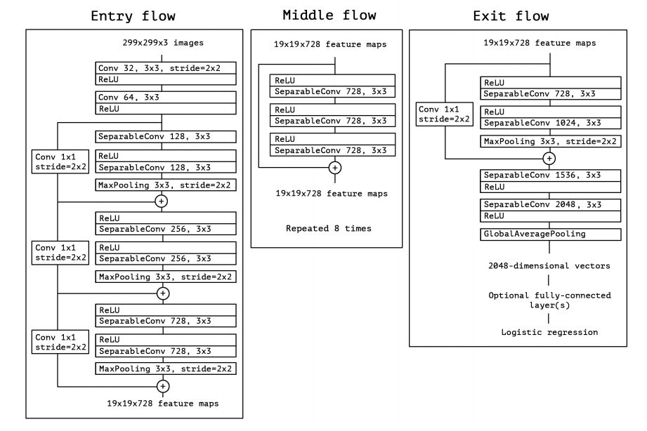
Model Structure
Separable convolution autoencoder (SCAE) based network is comprised of the encoder network and the decoder network.
Uses blocks from the Xception Model with Depthwise Separable Convolutions
Encoder: Xception and Middle blocks that consist of ReLU and 3 × separable conv blocks
Decoder: four upsampling layers and three convolution layers
https://maelfabien.github.io/deeplearning/xception/#the-limits-of-convolutions

Slide 15
Their Results
Improvements on DeepShip work:
Enhance noise variability robustness
Incorporate temporal evolution of acoustic signatures
Optimize computational resource requirements
Significance of these improvements:
Increase model accuracy and reliability
Make the model more accessible for lower resource environments
Method | Accuracy | Precision | Recall | F1-Score
SCAE | 77.53 | 78 | 77 | 77

